Slide 1
Electronics Workshop (9)
How to Install Dependencies

Slide 2
1. MINGW Installation
MINimalistic GNU for Windows
ABSOLUTE NECESSARY FOR COMPLING C/C++ Projects!
Launch mingw-get-setup.exe to install mingw manager
If mingw manager does not launch, search in windows

Slide 3
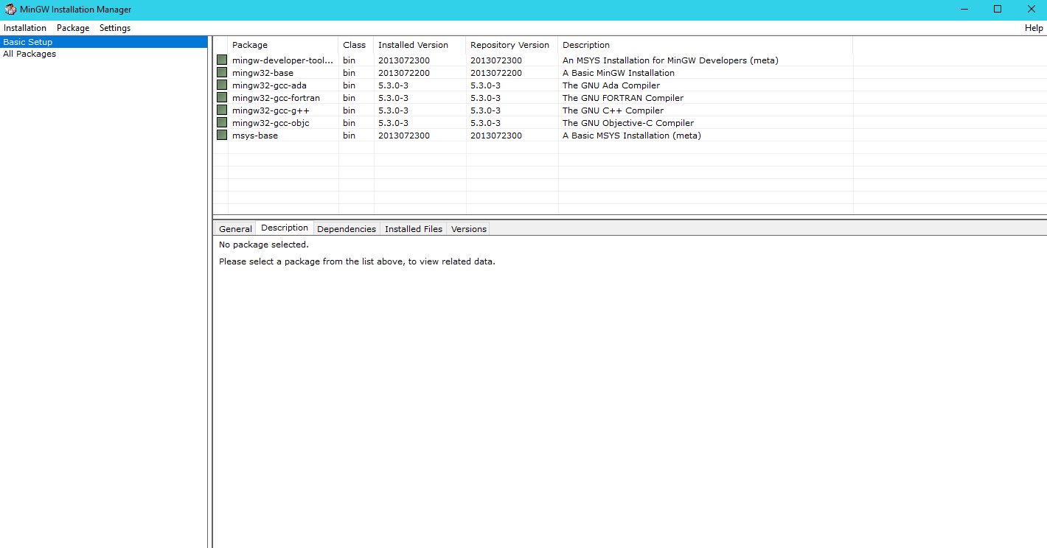
Click on ‘Basic Setup’ then click on tickbox to change status to ‘Mark for installation’

Slide 4
Click on ‘installation’ on top-left, then click ‘Apply Changes’ from dropdown.
This will automatically install all necessary files for compiling C/C++ projects.

Slide 5
Eclipse C/CPP IDE
Download Latest Version of Eclipse C/CPP IDE Here
https://eclipse.org/downloads/packages/eclipse-ide-cc-developers/keplersr2
Simply launch ‘eclipse.exe’ to launch Eclipse IDE
Be sure to set the project directory as Workshop folder’s C Project directory!
(Workshop_materials/C_Workshop_Files/Projects)
If you do not have not cloned github repository, you may have to download updated files again.

Slide 6
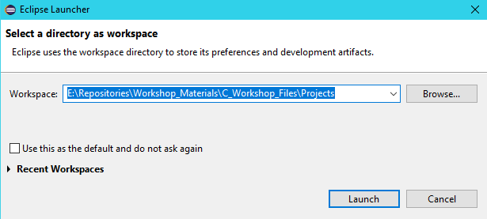

Slide 7
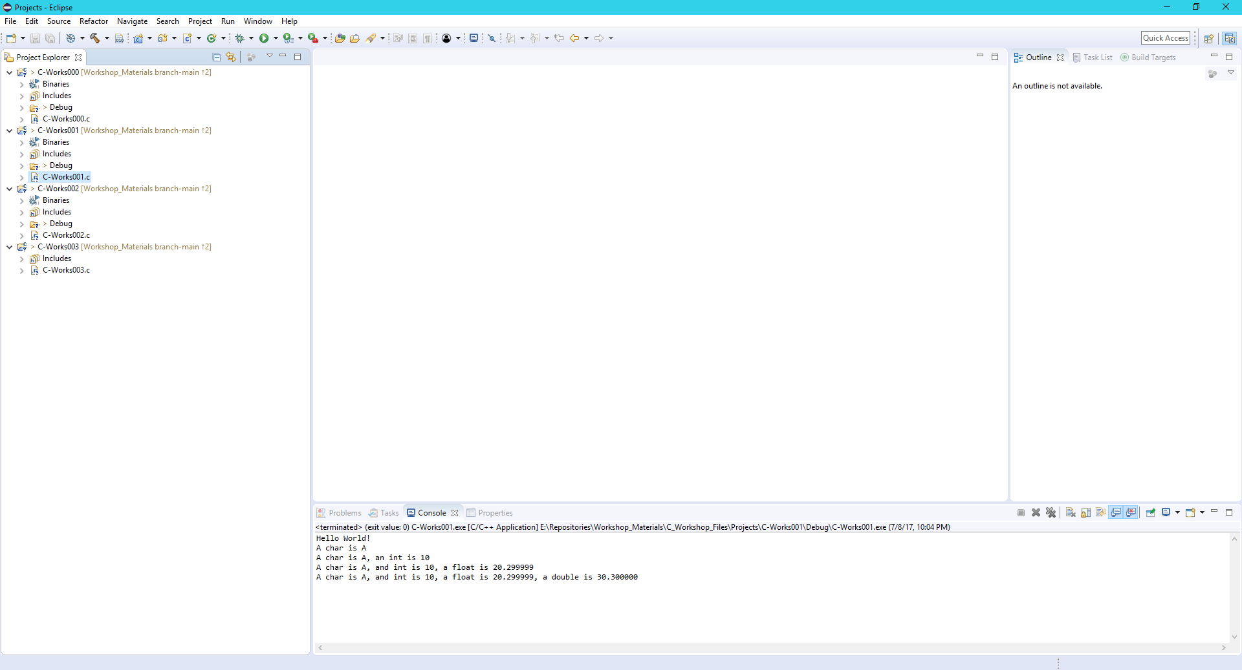
Should have list of projects on left

Slide 8
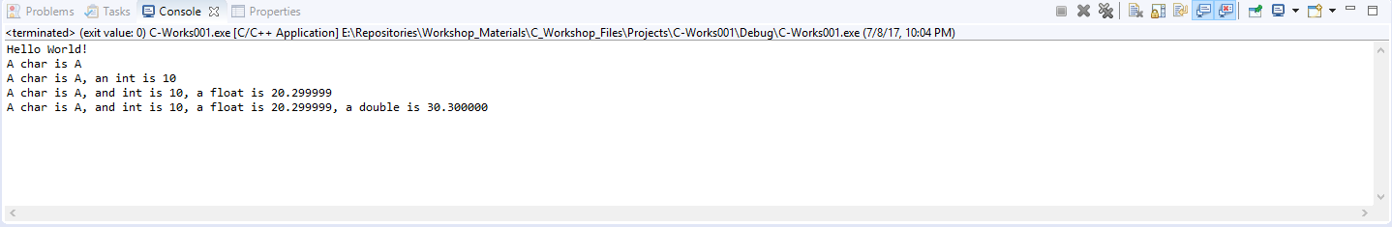
To test if everything installed correctly…
Open C-Works001.c
From top menu, click ‘Run->Run’
Or ctrl + F11 key
Output should be shown at the bottom

